Slide 1
Microsoft, Containers and Docker
Jennelle Crothers
Sr. Technical Evangelist
Microsoft Corporation

Slide 2

The cloud has changed expectations

Slide 3
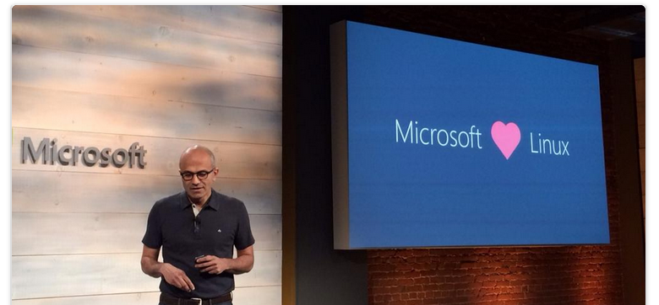

Slide 4
Expectations of Cloud Applications
Availability
Hyper-Scale
Agility

Slide 5
Why containers?

Slide 6
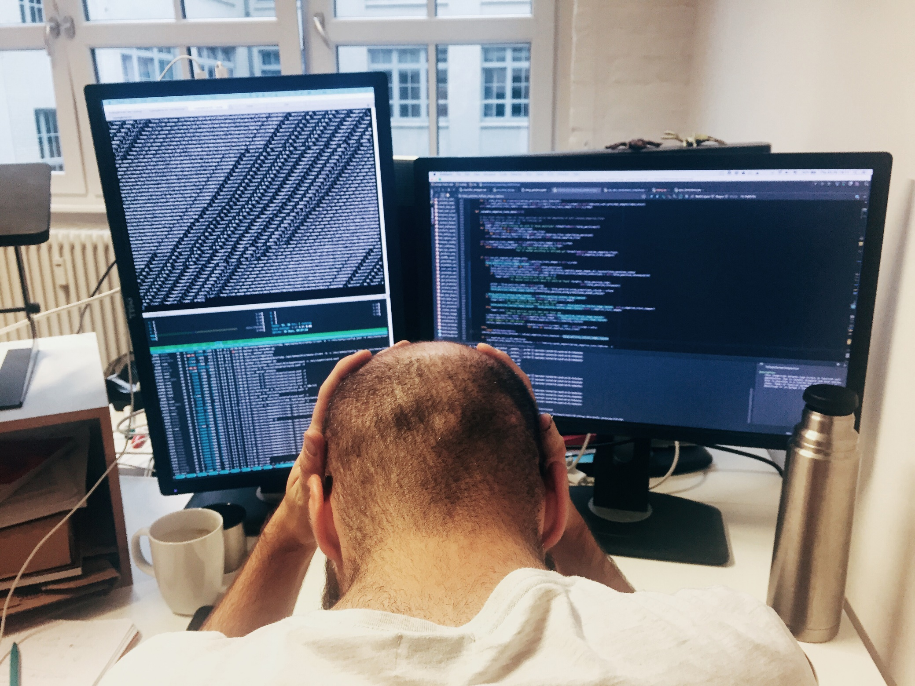
Why containers?
Transforming Existing Applications into Cloud Applications
Is Hard!
Building Hybrid Cloud
Applications
Is Hard!

Slide 7
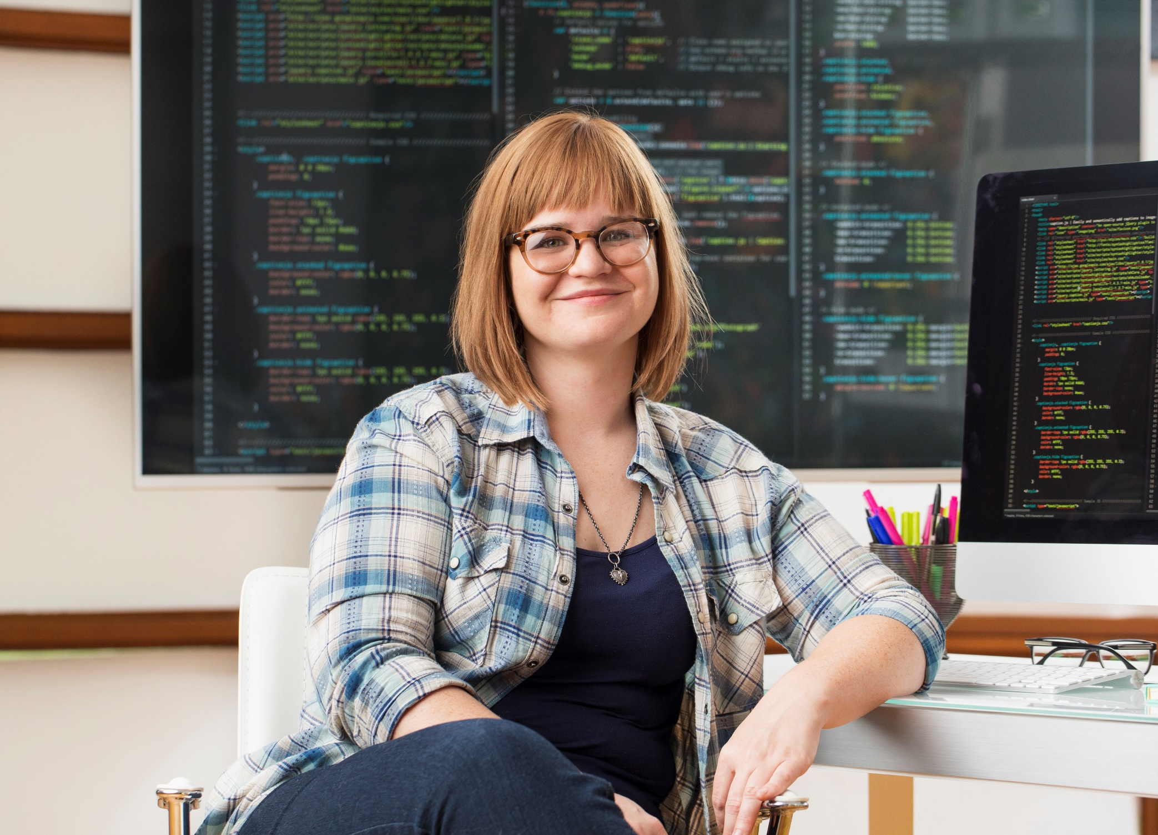
Why containers?
Containers Make It Much Easier…

Slide 8
How do containers make it easier?
Consistency
Efficiency
Rapid
Deployment
Fast Iterations
Service Separation
High Availability
Reproducibility
On Any Cloud
Scalability
Test at Scale
Immutability
Reduced Costs

Slide 9

Containers
Creation, deployment, and management
Developers update, iterate, and deploy updated containers
Physical/Virtual Servers
2
3
Operations collaborates with developers to provide app metrics and insights
Developers build and test apps in containers, using development environment
Operations automates deployment and monitors deployed apps from central repository
1
2
Containers pushed to central repository

Slide 10
You can do containers your way….

Slide 11
What ways exactly?

Slide 12
A few ways…
Linux Containers on Linux VMs
Clustered (or not) using IaaS with docker-machine
Linux Containers using Azure Container Services
With Docker, DC/OS or Kubernetes
Windows Containers on Windows Server 2016
Linux Containers on Windows 10 with Docker for Windows
Switching to Windows Containers is in the beta version.
Docker Datacenter in Azure Marketplace
30-Day Evaluation License Available via Docker

Slide 13
What is a container?

Slide 14
What is a container?
Application
OS
Hardware

Slide 15
What is a container?
Traditional virtual machines = hardware virtualization
Application
VM
VM
VM
OS
Hardware

Slide 16
What is a container?
Traditional virtual machines = hardware virtualization
Application
VM
VM
VM
OS
Hardware

Slide 17
What is a container?
OS
Hardware
Traditional virtual machines = hardware virtualization
Application
VM
VM
VM
OS
Hardware

Slide 18
What is a container?
Containers = Operating system virtualization
OS
Applications
Kernel
Hardware
Traditional virtual machines = hardware virtualization
Application
VM
VM
VM
OS
Hardware

Slide 19
What is a container?
Containers = Operating system virtualization
OS
CONTAINER
CONTAINER
CONTAINER
Applications
Kernel
Hardware
Traditional virtual machines = hardware virtualization
Application
VM
VM
VM
OS
Hardware

Slide 20
How about Windows containers?

Slide 21
What is a Windows container?
Containers = Operating system virtualization
OS
CONTAINER
CONTAINER
CONTAINER
Applications
Kernel
Hardware
Traditional virtual machines = hardware virtualization
Application
VM
VM
VM
OS
Hardware

Slide 22
What is a Windows container?
Containers = Operating system virtualization
Windows Server Containers
Maximum speed and density
OS
CONTAINER
CONTAINER
CONTAINER
CONTAINER
CONTAINER
CONTAINER
Applications
Kernel
Kernel
Hardware
Traditional virtual machines = hardware virtualization
Application
VM
VM
VM
OS
Hardware

Slide 23
Just like Linux containers…. With a bonus.
Containers = Operating system virtualization
Windows Server Containers
Maximum speed and density
OS
CONTAINER
CONTAINER
CONTAINER
CONTAINER
CONTAINER
CONTAINER
Applications
Kernel
Kernel
Hardware
Hyper-V Containers
Isolation plus performance
Traditional virtual machines = hardware virtualization
CONTAINER
CONTAINER
CONTAINER
Application
VM
VM
VM
OS
Kernel
Kernel
Kernel
Hyper-V
Hardware

Slide 24
Just like Linux containers…. With a bonus.
Containers = Operating system virtualization
Windows Server Containers
Maximum speed and density
This is a deployment choice, NOT a development one.
OS
CONTAINER
CONTAINER
CONTAINER
CONTAINER
CONTAINER
CONTAINER
Applications
Kernel
Kernel
Hardware
Hyper-V Containers
Isolation plus performance
Traditional virtual machines = hardware virtualization
CONTAINER
CONTAINER
CONTAINER
Application
VM
VM
VM
OS
Kernel
Kernel
Kernel
Hyper-V
Hardware

Slide 25
How do Windows containers work?

Slide 26
High Level Architecture
}
Docker Universal Control Plane
Container
Development and
Management Toolset
Docker Client
Docker PowerShell
Docker Compose
Docker Registry
Docker Swarm
Docker Engine
Operating System
Container Runtime

Slide 27
Windows Containers
Host User Mode
System Processes
Container Management
Session Manager
Docker Engine
Local Security Authority
Compute Services
Etc…
Windows Kernel
Hyper-V Hypervisor

Slide 28
Windows Containers
Host User Mode
System Processes
Container Management
Session Manager
Docker Engine
Local Security Authority
Windows Server Container
Compute Services
Etc…
Windows Kernel
Hyper-V Hypervisor

Slide 29
Windows Containers
Host User Mode
System Processes
Container Management
Session Manager
Docker Engine
Local Security Authority
Windows Server Container
Compute Services
Etc…
System Processes
Windows Kernel
Hyper-V Hypervisor

Slide 30
Windows Containers
Host User Mode
System Processes
Container Management
Session Manager
Docker Engine
Local Security Authority
Windows Server Container
Compute Services
Etc…
System Processes
Application Process(es)
Windows Kernel
Hyper-V Hypervisor

Slide 31
Windows Containers
Host User Mode
System Processes
Container Management
Session Manager
Docker Engine
Windows Server Container
Local Security Authority
Windows Server Container
Compute Services
System Processes
System Processes
Application Process(es)
Etc…
Application Process(es)
Windows Kernel
Hyper-V Hypervisor

Slide 32
Windows Containers
Host User Mode
System Processes
Container Management
Session Manager
Hyper-V Container
Docker Engine
Windows Server Container
Local Security Authority
Windows Server Container
Compute Services
System Processes
System Processes
Application Process(es)
Etc…
Application Process(es)
Windows Kernel
Hyper-V Hypervisor

Slide 33
Windows Containers
Host User Mode
System Processes
Container Management
Session Manager
Hyper-V Container
Docker Engine
Windows Server Container
Local Security Authority
Windows Server Container
Compute Services
System Processes
System Processes
Application Process(es)
Etc…
Application Process(es)
Windows Kernel
Windows Kernel
Hyper-V Hypervisor

Slide 34
Windows Containers
Host User Mode
System Processes
Container Management
Session Manager
Hyper-V Container
Docker Engine
Local Security Authority
Windows Server Container
Windows Server Container
Compute Services
Etc…
System Processes
Application Process(es)
System Processes
Application Process(es)
Windows Kernel
Windows Kernel
Hyper-V Hypervisor

Slide 35
Windows Containers
Host User Mode
Virtual Machine Specifically Optimized To Run a Container
System Processes
Container Management
Session Manager
Hyper-V Container
Docker Engine
Local Security Authority
Windows Server Container
Windows Server Container
Compute Services
Etc…
System Processes
Application Process(es)
System Processes
Application Process(es)
Windows Kernel
Windows Kernel
Hyper-V Hypervisor

Slide 36
Startup Performance
NodeJS with Nano Server
NodeJS with Windows Server Core
Hyper-V Container
~1.75 seconds
Windows Server Container
Under 600 Milliseconds!
Hyper-V Container
~3.3 seconds
Windows Server Container
~1 second
A virtual machine takes ~3 seconds
A virtual machine takes ~5 seconds to over a min
*Includes initial boot provisioning phase (out-of-box setup etc…)
**Startup time after initial container start.
Testing performed on HP ProLiant SL250s Gen8, E5-2600, 2 Socket, 8 Core, 128GB RAM, HP SATA SSD - results may vary based on hardware and software configurations.

Slide 37
Startup Performance
NodeJS with Nano Server
Windows Server Container
Under 600 Milliseconds!
Hyper-V Container
~1.75 seconds
A virtual machine takes ~3 seconds
NodeJS with Windows Server Core
Windows Server Container
~1 second
Hyper-V Container
~3.3 seconds
A virtual machine takes ~5 seconds to over a min

Slide 38
Density
NodeJS with Nano Server
NodeJS with Windows Server Core
Hyper-V Container
First Container ~340MB
Additional Containers ~150MB
Windows Server Container
First Container ~120MB
Additional Containers ~75MB
Hyper-V Container
First Container ~555MB
Additional Containers ~280MB
Windows Server Container
First Container ~150MB
Additional Containers ~75MB
Testing performed on HP ProLiant SL250s Gen8, E5-2600, 2 Socket, 8 Core, 128GB RAM, HP SATA SSD - results may vary based on hardware and software configurations.

Slide 39
Density
NodeJS with Nano Server
Windows Server Container
First Container ~120MB
Additional Containers ~75MB
Hyper-V Container
First Container ~340MB
Additional Containers ~150MB
NodeJS with Windows Server Core
Windows Server Container
First Container ~150MB
Additional Containers ~75MB
Hyper-V Container
First Container ~555MB
Additional Containers ~280MB

Slide 40


Docker integration Joint strategic investments to drive containers forward
Customer
Datacenter
Docker: An open source engine that automates the deployment of any application as a portable, self-sufficient container that can run almost anywhere
Partnership: Enable the Docker toolset to manage multi-container applications using both Linux and Windows containers, regardless of the hosting environment or cloud provider
Dockerized app
Windows Server
Container
Linux Container
Run anywhere
Microsoft
Azure
Service
Provider
Docker
Investments in the next wave of Windows Server
Open source development of the Docker Engine for Windows Server
Azure support for the Docker Open Orchestration APIs
Federation of Docker Hub images into the Azure Gallery and Portal
Strategic investments

Slide 41


Docker integration Joint strategic investments to drive containers forward
Docker Hub in Azure: Huge collection of open and curated applications available for download
Collaboration: Bring Windows Server containers to the Docker ecosystem to expand the reach of both developer communities
Docker Engine: Docker Engine for Windows Server containers will be developed under the aegis of the Docker open source project
Docker client: Windows customers will be able to use the same standard Docker client and interface on multiple development environments
Docker Client
Docker.exe
Examples:
docker run
docker images
Windows Server
Linux
Docker Remote API
Examples:
GET images/json
POST containers/create
Docker Engine
(Daemon)
Docker Engine
(Daemon)
Windows Server
Container Support
Linux Container
Support (LXC)

Slide 42
How do I create a container?

Slide 43
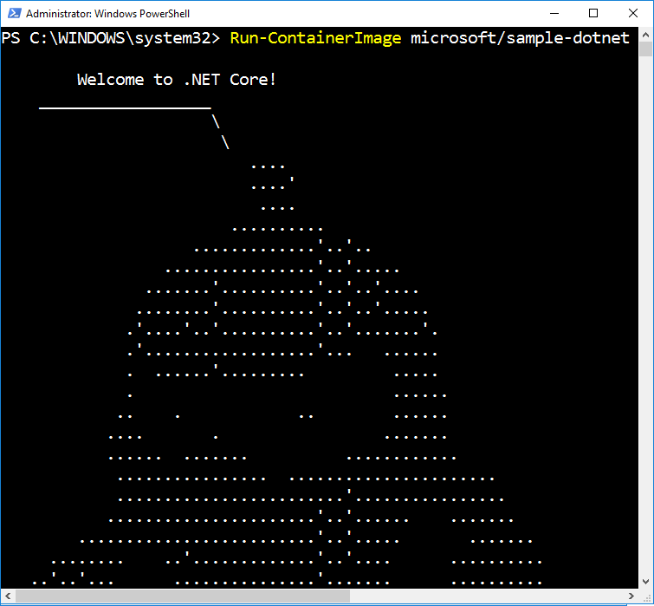
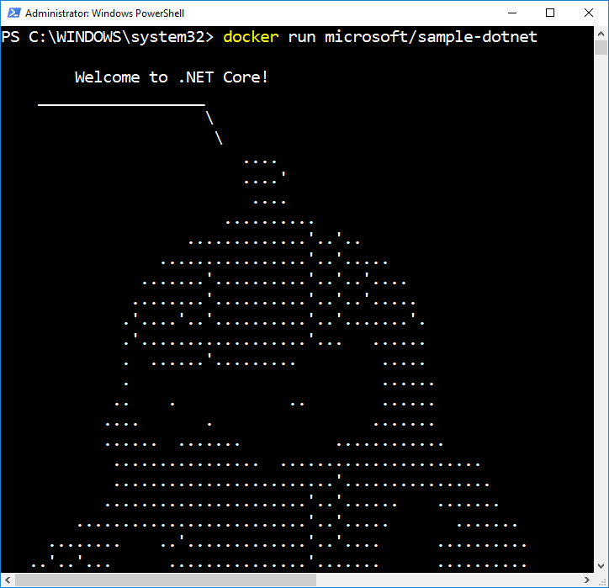
Docker Run
Creates and Starts a New Container
Runtime options
Name (network name and management name)
Interactive or Service
Network configuration
Resource management
Volume mappings
Isolation level

Slide 44
What is a container image?

Slide 45

Container Image
Analogous to a VHD and config file to a virtual machine
Created by running a container and capturing changes
Changes include files and registry
Image
Metadata Name,
Creation Data,
Command To Execute,
Dependences
Contents
Registry
Files
Folders

Slide 46
Container Images
My Website
Application
IIS
Application Framework
Base Image (OS)

Slide 47
Container Images
My Website
Application
IIS
Application Framework
Image Contents
Registry
Folders and Files
HKLM
HKCU
License.txt
PerfLogs
Program Files
Base Image (OS)
HKCR
HKU
Program Files (x86)
Users
Windows

Slide 48
Container Images
Image Contents
Registry
Folders and Files
My Website
Application
HKLM
inetpub
mysite.html
IIS
SOFTWARE/mykey
Application Framework
Image Contents
Registry
Folders and Files
HKLM
HKCU
License.txt
PerfLogs
Program Files
Base Image (OS)
HKCR
HKU
Program Files (x86)
Users
Windows

Slide 49
Automated Image Building
Docker Build and Dockerfiles
Method for automated container image build
Consumed when running “docker build”
Caches unchanged commands
Integrates into Docker Hub
Examples
IIS
FROM windowsservercore
RUN powershell –command Add-WindowsFeature Web-Server
Website
FROM iis
ADD mysite.htm inetpub\mysite.htm
My Website
IIS

Slide 50
Image Registries
What is a registry?
Stores container images
Images are Pushed into a registry
Images are Pulled from a registry
Images are Searched for within a registry

Slide 51
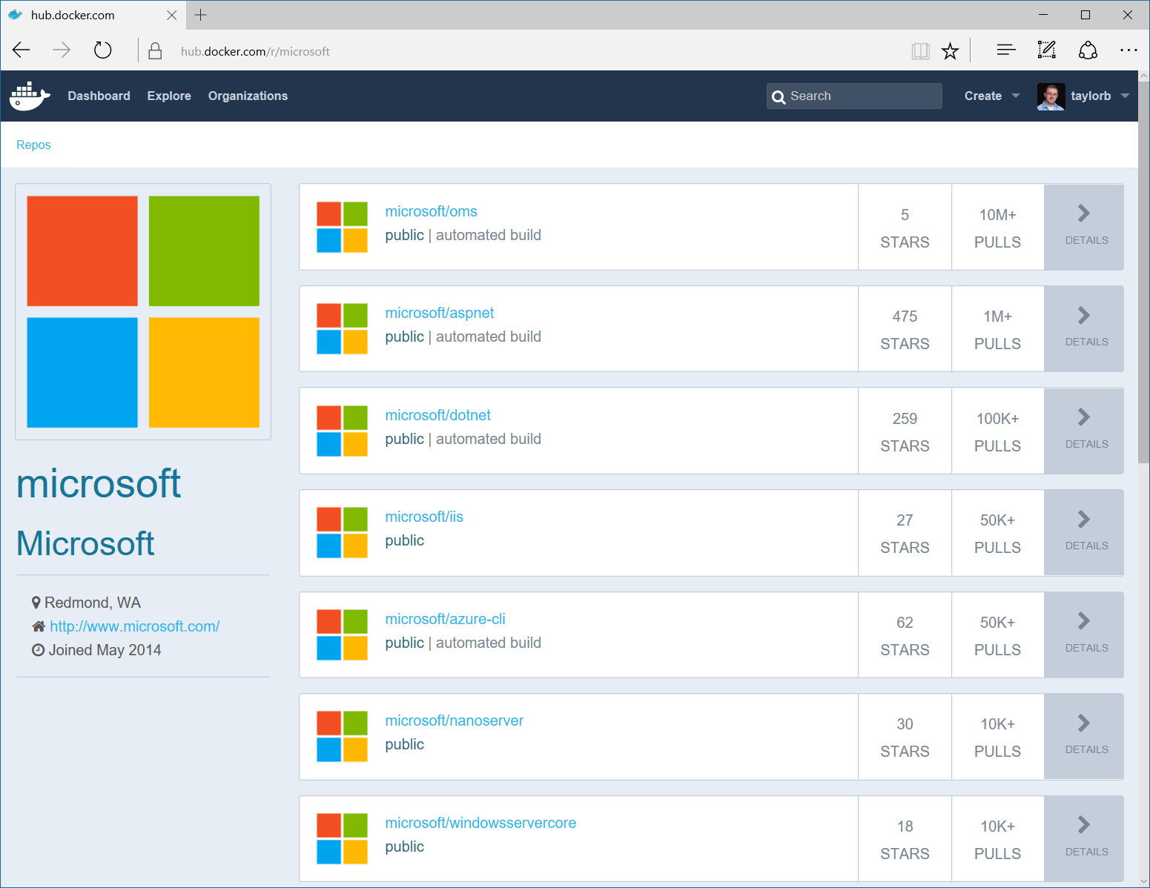
Image Registries
Docker Hub and Docker Store
Public, Official and Private image repositories
Granular access controls with organization support
Automated image build support
Docker Trusted Registry
Enterprise Grade Private Registries
Runs on your infrastructure (on-prem or cloud)
Active Directory and Role Based Access Controls
Docker Registry
Open source foundation of Hub and DTR
Runs on your infrastructure (on-prem or cloud) as a container
https://docs.docker.com/registry and or https://github.com/docker/distribution
Azure Container Registry
Currently in Preview
Store your container image in local, network-close storage on Azure
Use Azure Active Directory to manage access
Manage Windows and Linux container images in a single registry

Slide 52
What about…

Slide 53
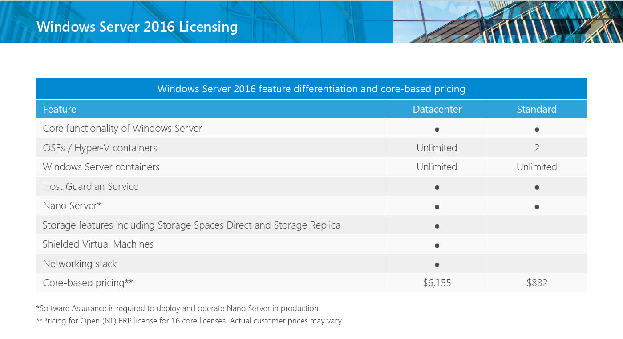
Licensing
https://www.microsoft.com/en-us/cloud-platform/windows-server-pricing

Slide 54
Patching and Updates
Update Container OS Image
Pull updated base image
Rebuild containers using dockerfiles
My Website
IIS
10.0.14393.0

Slide 55
Patching and Updates
Update Container OS Image
Pull updated base image
Rebuild containers using dockerfiles
My Website
IIS
10.0.14393.0

Slide 56
Patching and Updates
Update Container OS Image
Pull updated base image
Rebuild containers using dockerfiles
My Website
IIS
KB123456 = new image on Docker Hub
10.0.14393.0
10.0.14393.1

Slide 57
Patching and Updates
Update Container OS Image
Pull updated base image
Rebuild containers using dockerfiles
My Website
IIS
IIS
FROM windowsservercore
RUN powershell –command Add-WindowsFeature Web-Server
KB123456 = new image on Docker Hub
10.0.14393.0
10.0.14393.1

Slide 58
Patching and Updates
Update Container OS Image
Pull updated base image
Rebuild containers using dockerfiles
My Website
My Website
FROM iis
ADD mysite.htm inetpub\mysite.htm
IIS
IIS
FROM windowsservercore
RUN powershell –command Add-WindowsFeature Web-Server
KB123456 = new image on Docker Hub
10.0.14393.0
10.0.14393.1

Slide 59
Patching and Updates
Update as a new layer
Download update in container (ala run Windows Update in the container)
When container is stopped update is applied as a new layer
My Website
IIS
10.0.14393.0

Slide 60
Patching and Updates
Update as a new layer
Download update in container (ala run Windows Update in the container)
When container is stopped update is applied as a new layer
My Website
IIS
10.0.14393.0

Slide 61
Patching and Updates
Update as a new layer
Download update in container (ala run Windows Update in the container)
When container is stopped update is applied as a new layer
My Website
IIS
Same Image
10.0.14393.0
10.0.14393.0

Slide 62
Patching and Updates
Update as a new layer
Download update in container (ala run Windows Update in the container)
When container is stopped update is applied as a new layer
My Website
My Website
Same Image
IIS
IIS
Same Image
Same Image
10.0.14393.0
10.0.14393.0

Slide 63
Patching and Updates
Update as a new layer
Download update in container (ala run Windows Update in the container)
When container is stopped update is applied as a new layer
KB123456
My Website
My Website
Same Image
IIS
IIS
Same Image
Same Image
10.0.14393.0
10.0.14393.0

Slide 64
Resource Controls
CPU
Percent of host CPU container can consume
Memory
Maximum memory container can consume
Disk
Maximum IO bandwidth on the system drive
Maximum IOPs limit on the system drive
Network
Platform support for egress caps

Slide 65
Networking
Fully Manageable with Docker
Network creation/enumeration
Service Discovery
Optimized for Microsoft Cloud Stack
Advanced network policy (ACLs, QoS) can be assigned per container endpoint
Load Balancing can be handled through the Microsoft Software Load Balancer (Coming Soon)
Area of Regular and Continuous Innovation
Docker tooling support (Compose) for networking (Limited Support at GA)
Integration with other Orchestrators (Kubernetes, Swarm, etc.)
Native Overlay network driver
Multiple networks (NAT and overlay) per host

Slide 66
Storage
Container Image
Not designed for persistent data
Not designed for secrets
“Volumes”
Enables storage persistence
Enables mapping of storage into containers
Read-Only or Read/Write
Multiple containers on the same host can access the same location
Plug-In Architecture
Network Storage
Containers access SMB shares
Accessed though the containers network

Slide 67
Volume Mapping
My Container
Container Host
Container Host

Slide 68
Volume Mapping
Image Contents
My Container
License.txt
PerfLogs
Program Files
Program Files (x86)
Users
Windows
Host Storage
C:
D:
Container Host
Container Host
ContainerData

Slide 69
Storage Volume Mapping Example
Running a Container
docker run –v d:\ContainerData:c:\data mycontainer
Image Contents
My Container
License.txt
PerfLogs
Program Files
Program Files (x86)
Users
Windows
Host Storage
C:
D:
Container Host
Container Host
ContainerData

Slide 70
Volume Mapping
Running a Container
docker run –v d:\ContainerData:c:\data mycontainer
Image Contents
My Container
License.txt
PerfLogs
Program Files
Container View
Program Files (x86)
Users
Windows
Host Storage
License.txt
PerfLogs
Program Files
C:
D:
Program Files (x86)
Users
Windows
data
Container Host
Container Host
ContainerData

Slide 71
Volume Mapping
Running a Container
docker run –v d:\ContainerData:c:\data mycontainer
Image Contents
My Container
License.txt
PerfLogs
Program Files
Container View
Program Files (x86)
Users
Windows
Host Storage
License.txt
PerfLogs
Program Files
C:
D:
Program Files (x86)
Users
Windows
data
Container Host
Container Host
ContainerData

Slide 72


Volume Driver Plug-In’s
Automate mapping storage from into containers
Ecosystem Partners
http://www.nimblestorage.com
http://www.netapp.com

Slide 73
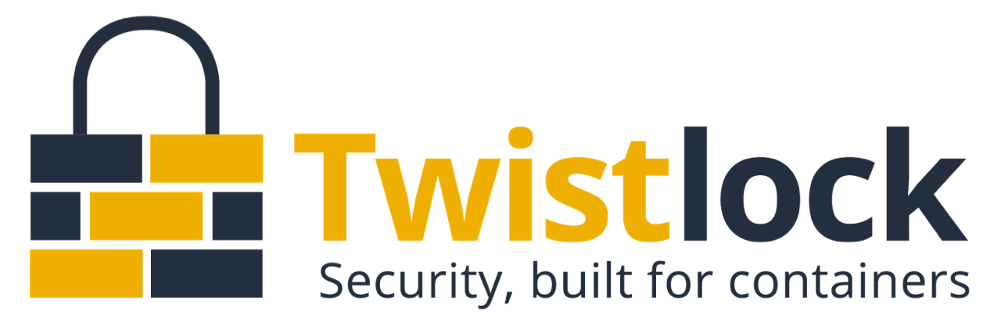

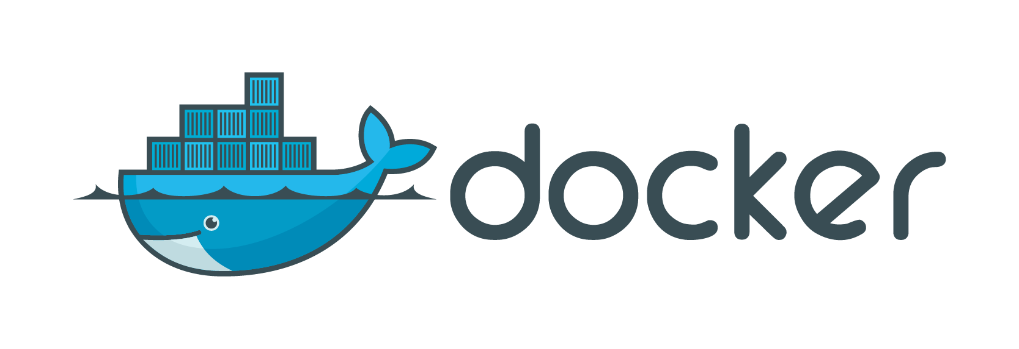
Secure Deployment and Auditing

Slide 74
Automation and Management

Slide 75

Composition and Orchestration
Applications typically comprised of multiple containers
Containers typically hosted across a cluster of nodes
Orchestration tooling automates this

Slide 76
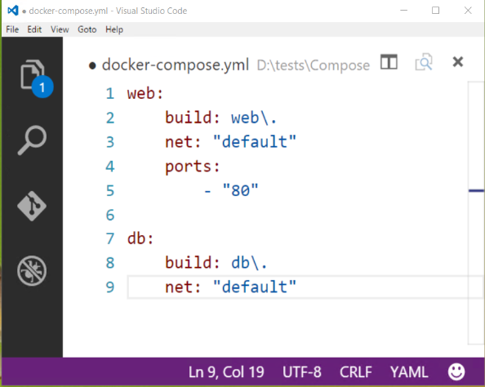
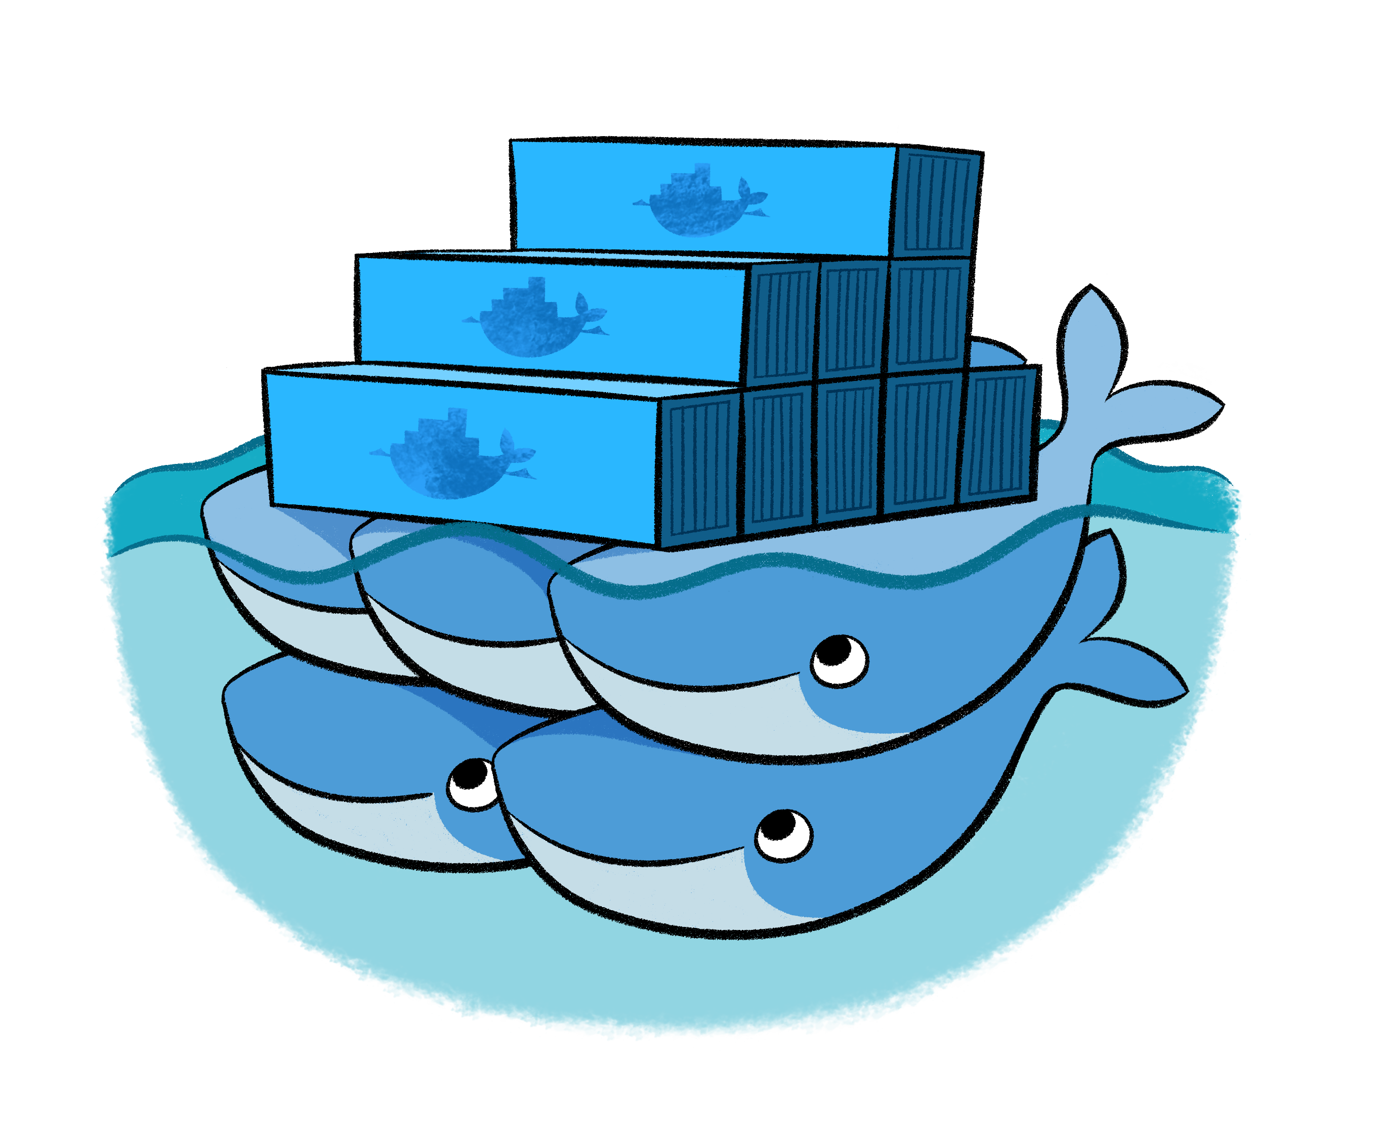
Composition and Orchestration
Docker Compose
Define application as separate containers
Manage different containers as a unit
Scale parts of application as needed
Docker Swarm
Aggregate container hosts
Supports tagging, affinity/anti-affinity

Slide 77
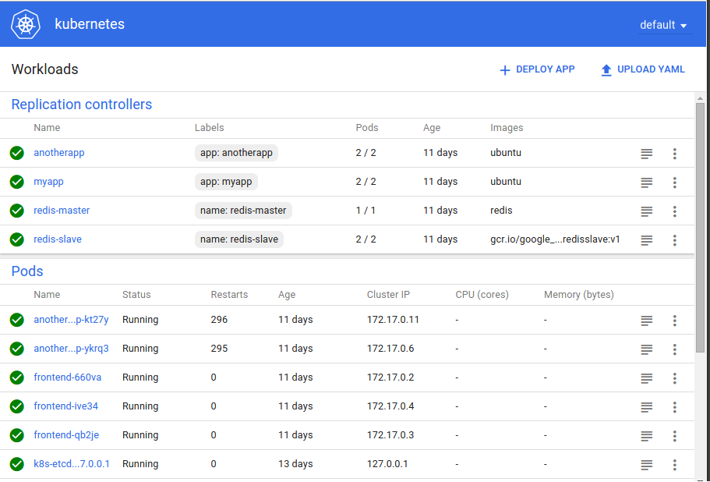
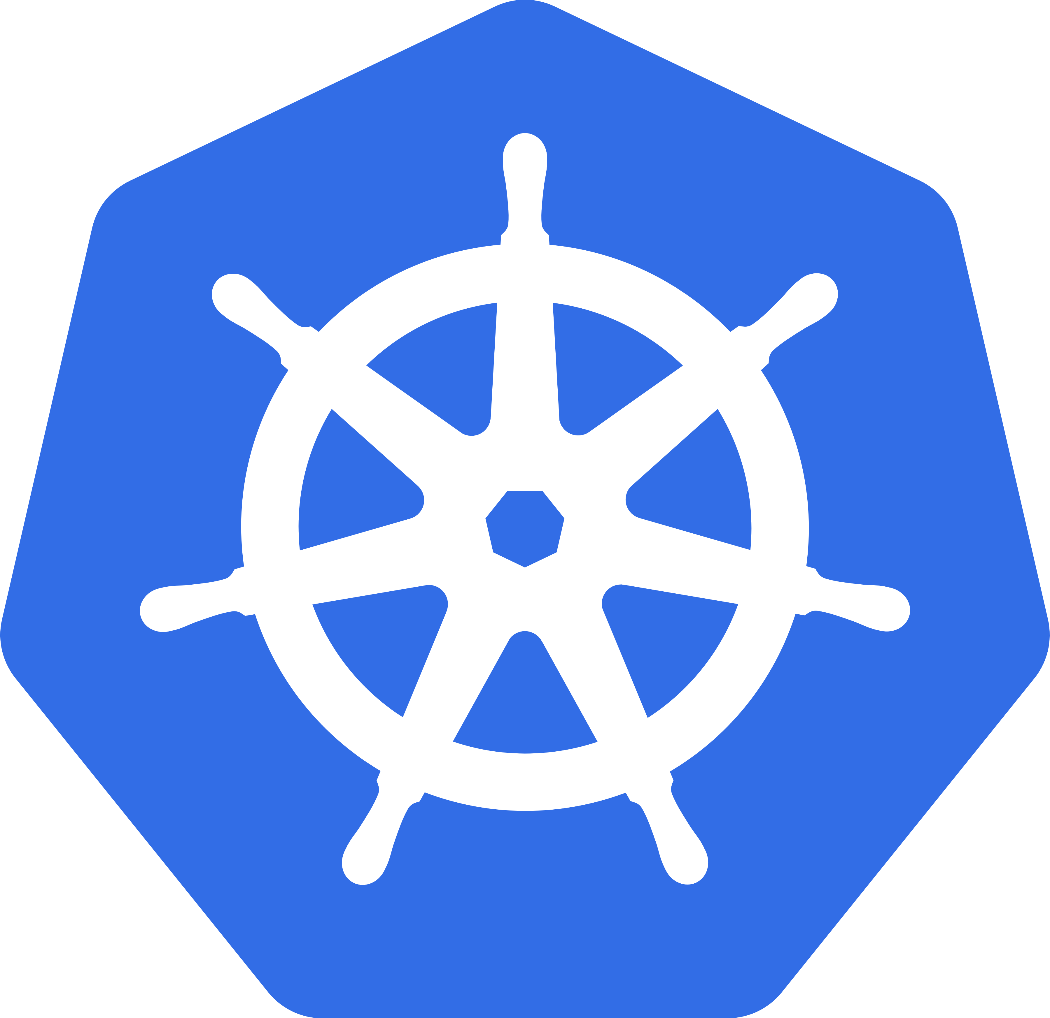
Composition and Orchestration
Kubernetes
Open source project started by Google
Windows support being added though community partnership spear headed by Apprenda

Slide 78
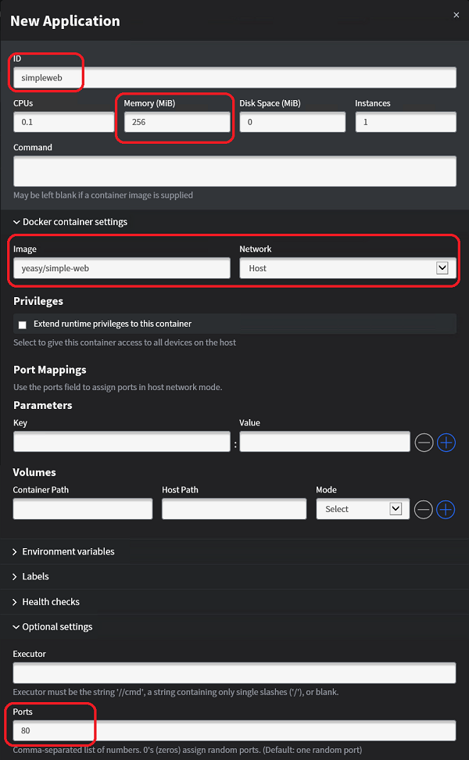

Composition and Orchestration
Mesos/Mesosphere + Marathon
Aggregates container hosts
Web based UI
Service Launch and Discovery

Slide 79


Azure Container Service
Azure
Standard Docker tooling and API support
Streamlined provisioning of Docker Swarm, DCOS and recently Kubernetes
Linux and Windows Server containers
Azure and Azure Stack
Swarm
DC/OS

Slide 80
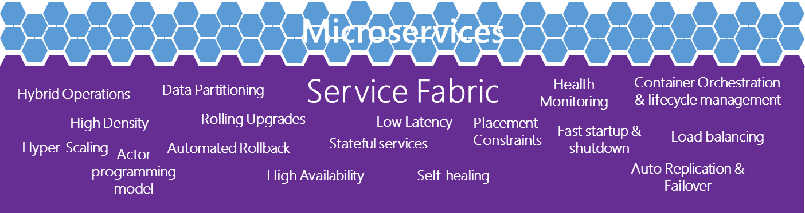
Where containers are going Microservices
Small composed parts
Easy development
Easy scale-out
Easy update
Service fabric

Slide 81
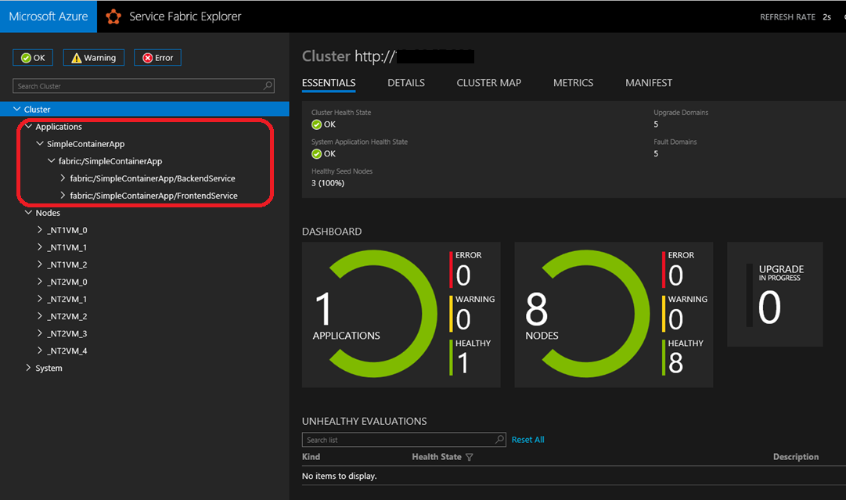

Composition and Orchestration
Azure Service Fabric
Microservice and orchestration platform
Build applications as containers and/or microservice
Available on Windows & Linux
Built-in cross-container communication
Web based management UI
Available On-Prem, Azure or other Clouds
Can orchestrate anything:
A random exe, some java app,
a containerized app or a microservice
that uses Service Fabric’s APIs
Notes:
Service Fabric supports orchestrating containers as well as processes across a cluster of machines. It can orchestrate anything whether it’s a random exe, some java app, a containerized application, or an actual microservice that takes advantage of Service Fabric’s programming model APIs.

Slide 82
Management and Monitoring Tools
Docker Datacenter
Docker Trusted Registry
Docker Universal Control Plane
Docker Swarm
Commercially Supported Docker Engines
Docker Engine
Docker Engine
Docker Engine
Docker Engine
Docker Engine
Compute
Private Cloud
Public Cloud

Slide 83
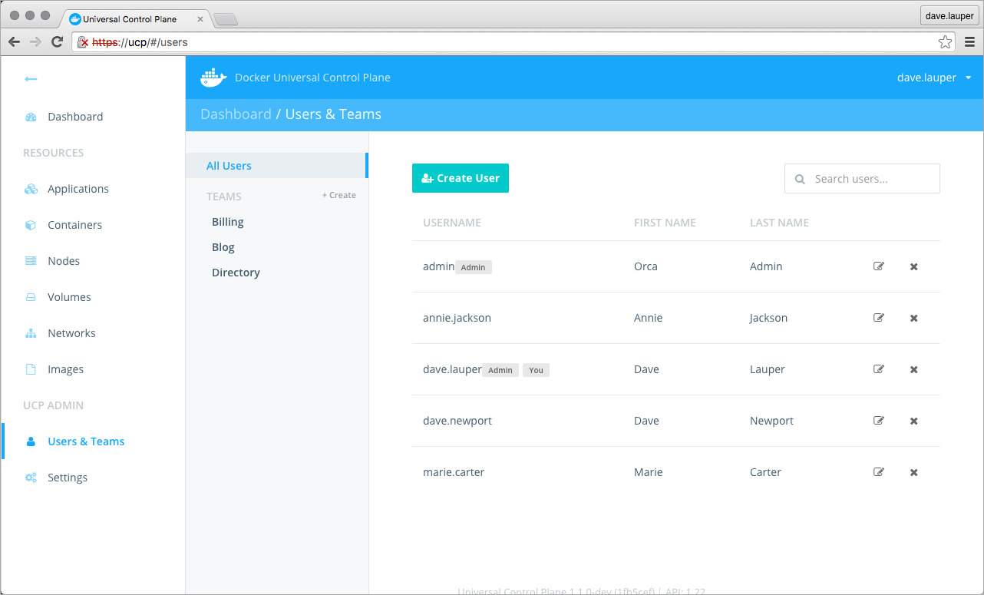
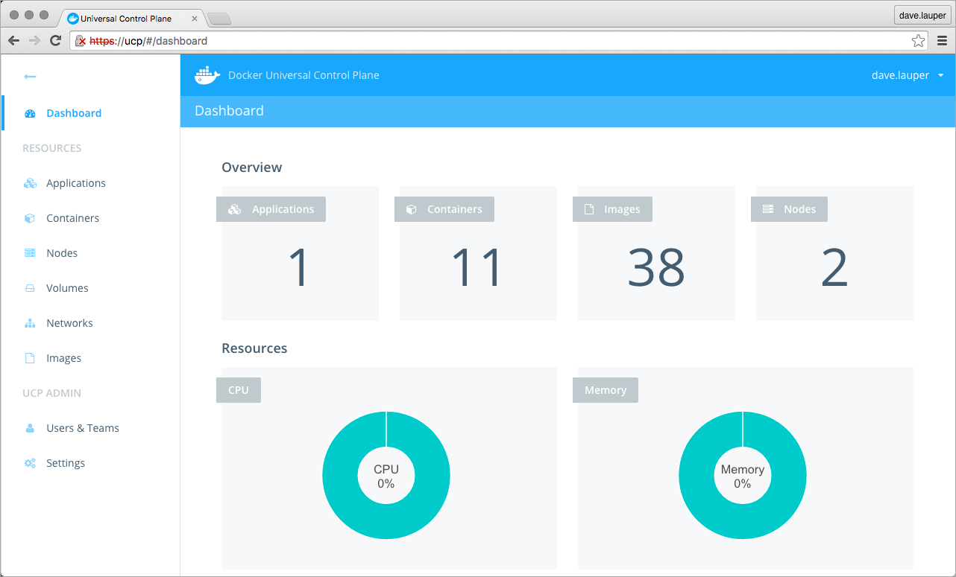
Management and Monitoring Tools
Docker Datacenter

Slide 84
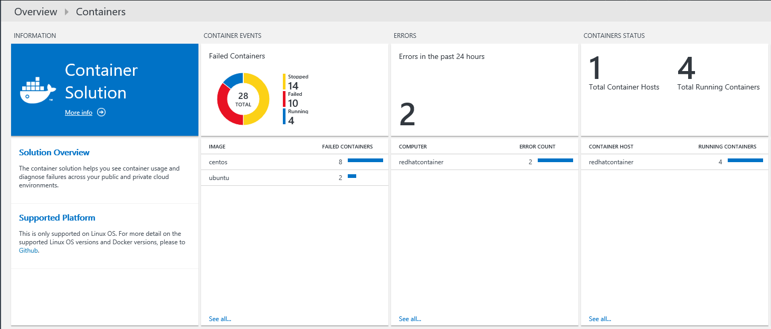
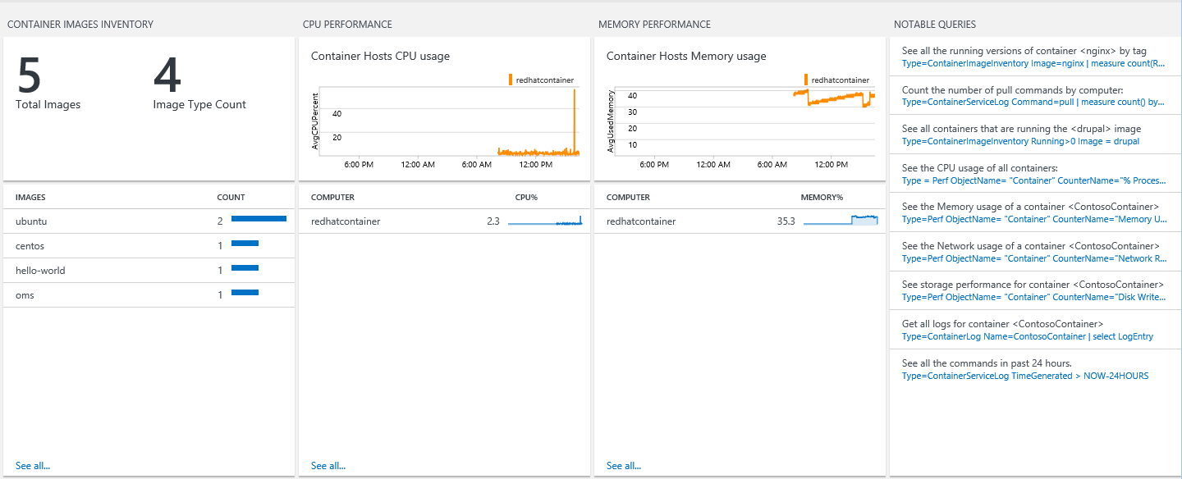
Microsoft Operations Management Suite
Monitoring Solution for Docker
Syslog events
Performance metrics
Container data

Slide 85
Development Tools

Slide 86

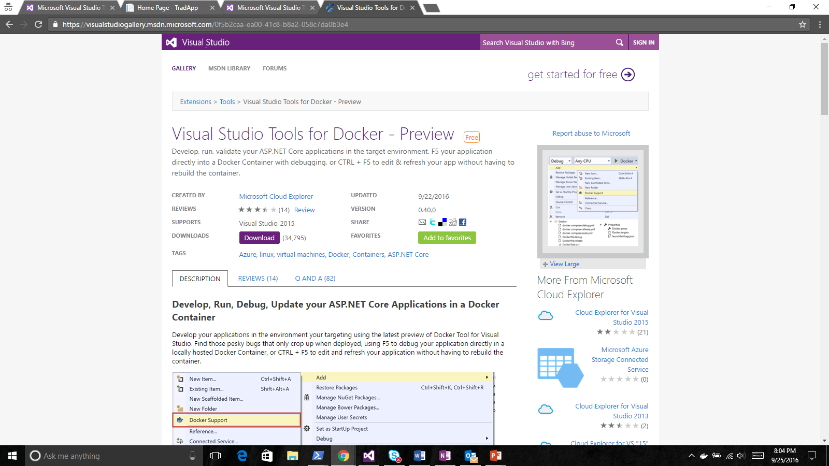
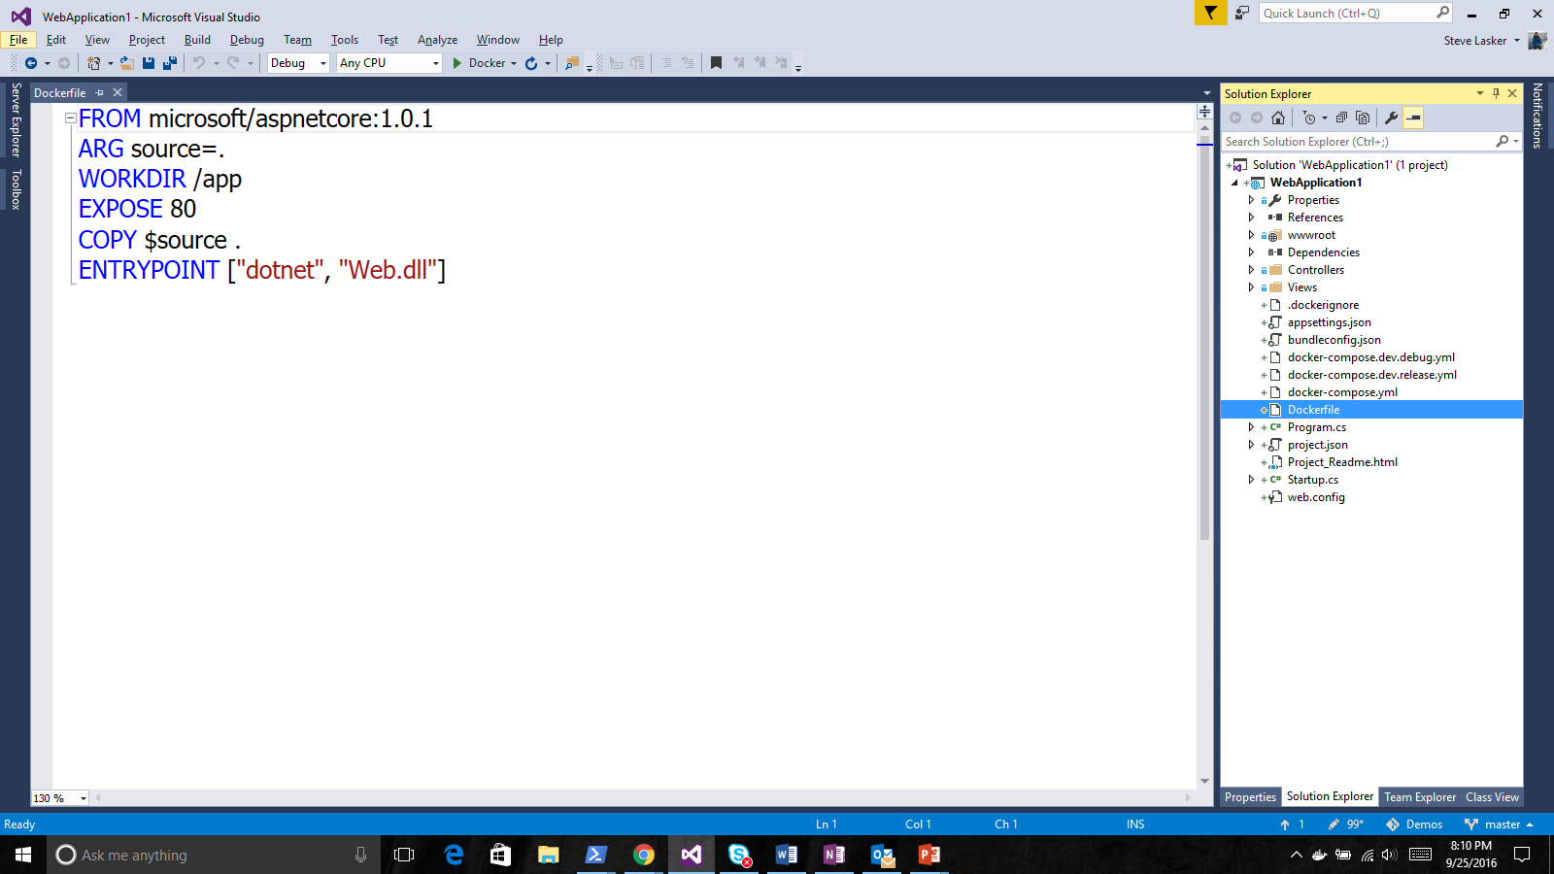
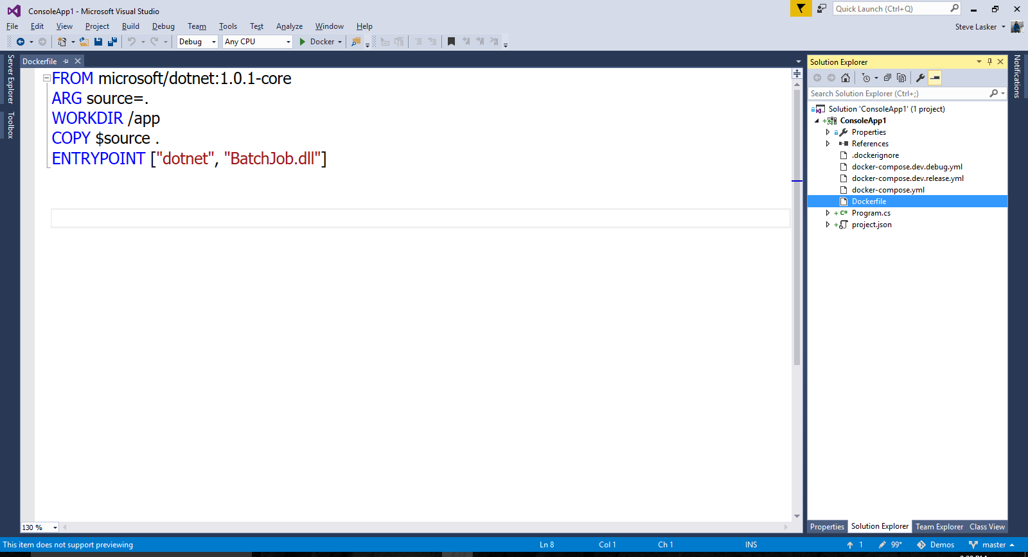
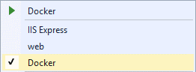
Visual Studio Docker Tools
Run, Debug, Test Web & Console apps in docker containers
Linux today, Windows Server & Nano Server coming soon
F5 Debugging
Edit & Refresh of code
Scaffolds docker assets
Dockerfile, docker-compose.yml
aka.ms/DockerToolsForVS

Slide 87











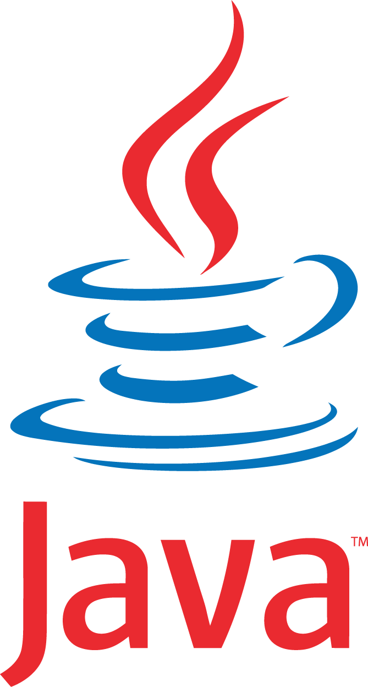








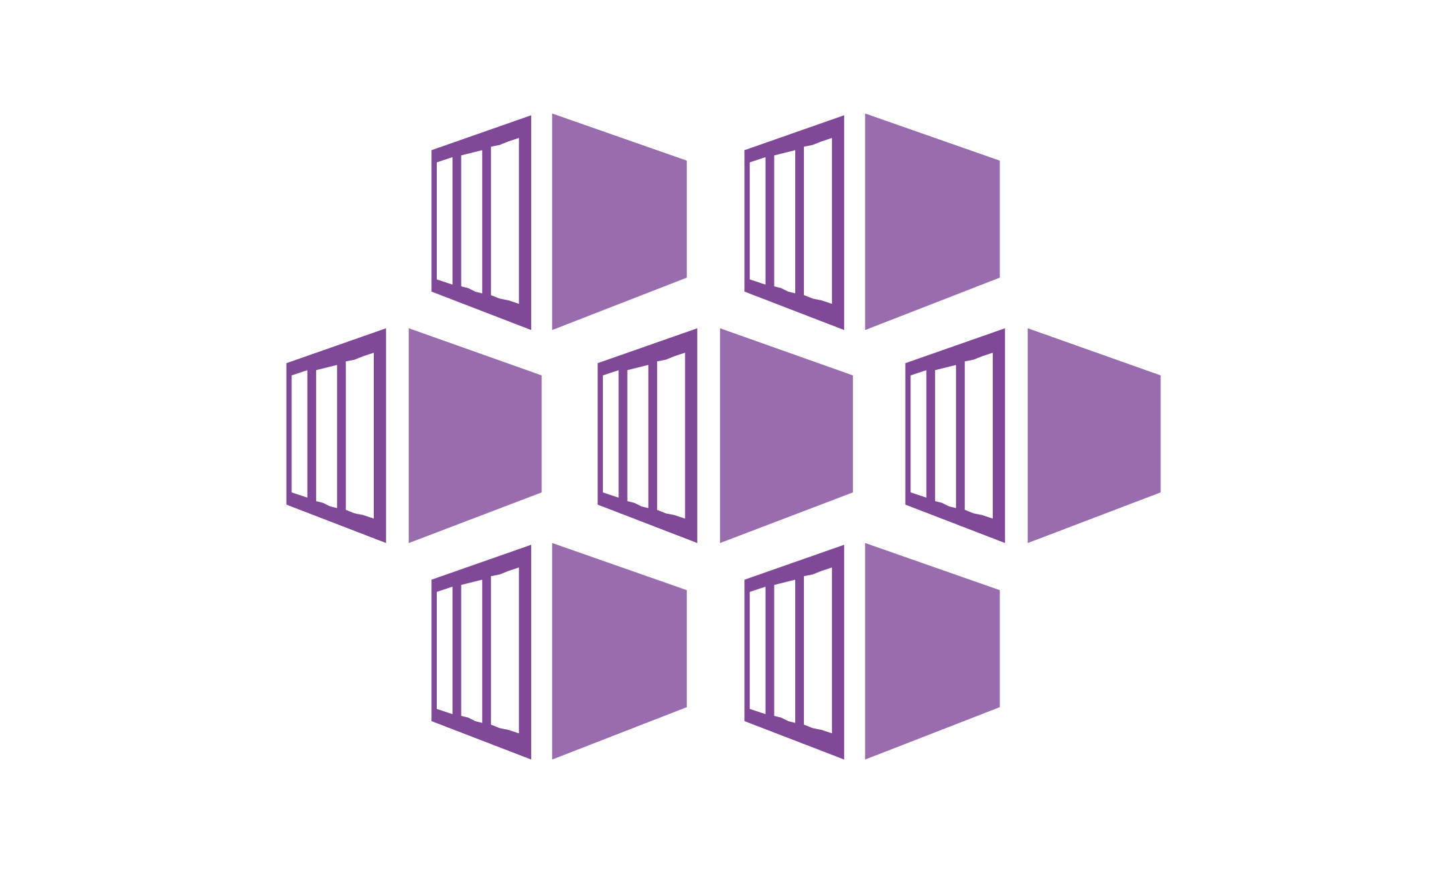








Build and run open source solutions
Any tool, application, framework
Applications
DevOps
Frameworks
Databases & middleware
Containers
Infrastructure
Notes:
We’re heavily invested in open-source technologies and partnerships, as evidenced on this slide. Nearly one in three Azure virtual machines are now running Linux, and we support Linux as a first class citizen.
Why is this important to Microsoft? Because it’s in the best interest of our customers. In fact, over 40% of CIOs are using open source as their primary strategy heading into 2017. We support our customers’ computing, whatever it is and wherever it is.
Finally, we contribute to the open source community as well as build some of our services on open source technology, like HDInsight and Azure Container Service. This also helps us scale to our customers’ needs as we rapidly release cloud solutions.

Slide 88
Additional Information
Lab Location: https://github.com/techbunny/ContainerCamp
Learn more about ARM/JSON Templates:
https://blog.techbunny.com/tag/json/

Slide 89

Microsoft | Container Camp Attendee Evaluation
Please take a few minutes to answer our short survey BEFORE you leave the event today!
To receive the evaluation link for this event, text MICROSOFT CCSF to 878787. By doing so you agree that Microsoft can send you an automated message to this mobile phone.
You can access the evaluation here:
http://aka.ms/devopssf
Provide the email you used to register for this event, select the attendee evaluation and complete the evaluation. Thank you for your feedback!
© 2016 Microsoft Corporation. All rights reserved. Microsoft, Windows, Windows Vista and other product names are or may be registered trademarks and/or trademarks in the U.S. and/or other countries.
The information herein is for informational purposes only and represents the current view of Microsoft Corporation as of the date of this presentation. Because Microsoft must respond to changing market
conditions, it should not be interpreted to be a commitment on the part of Microsoft, and Microsoft cannot guarantee the accuracy of any information provided after the date of this presentation.
MICROSOFT MAKES NO WARRANTIES, EXPRESS, IMPLIED OR STATUTORY, AS TO THE INFORMATION IN THIS PRESENTATION.

